Slide 1
Image Segmentation – Region Growing, Split and Merge

Slide 2
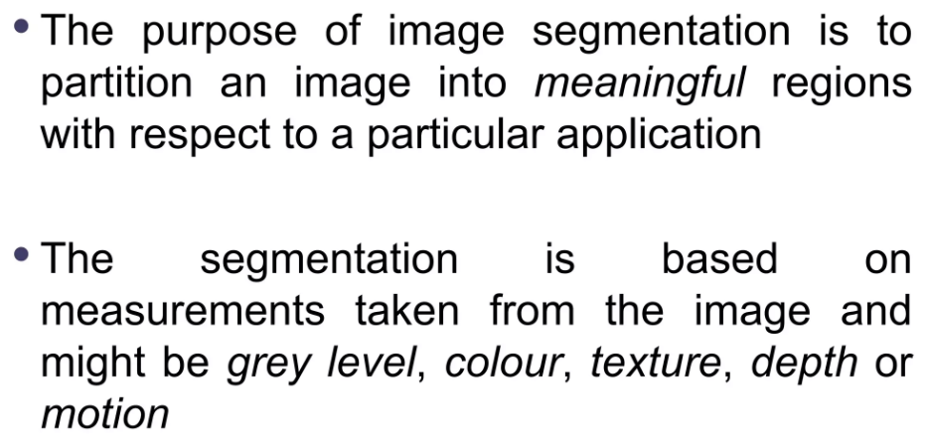
Segmentation

Slide 3
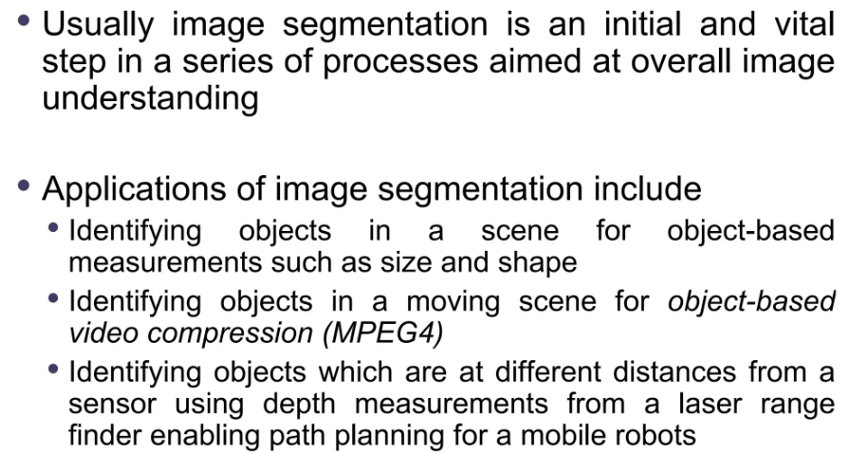

Slide 4
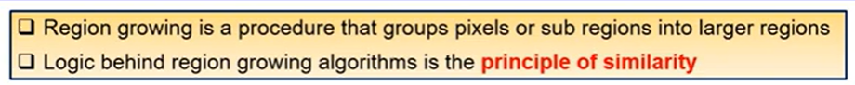
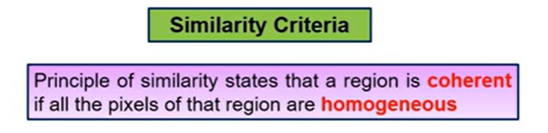
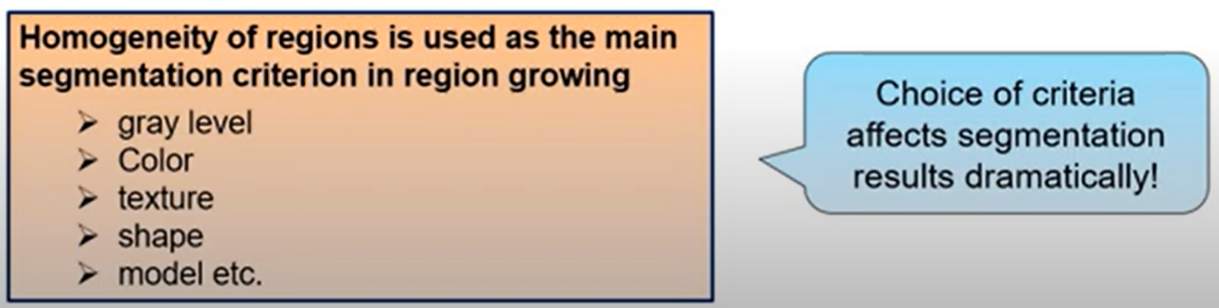
Region Growing

Slide 5
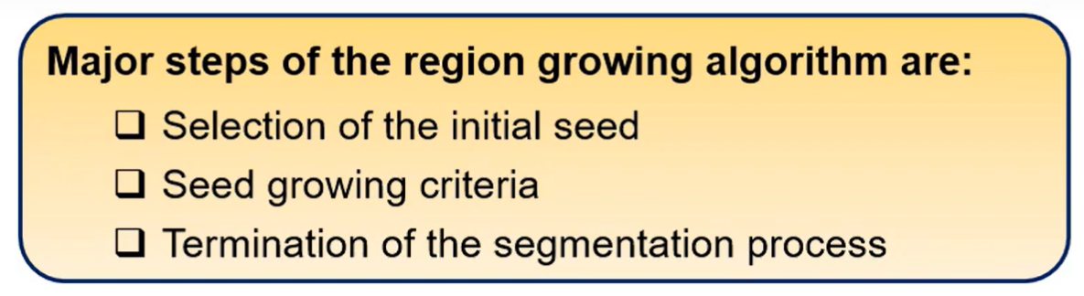
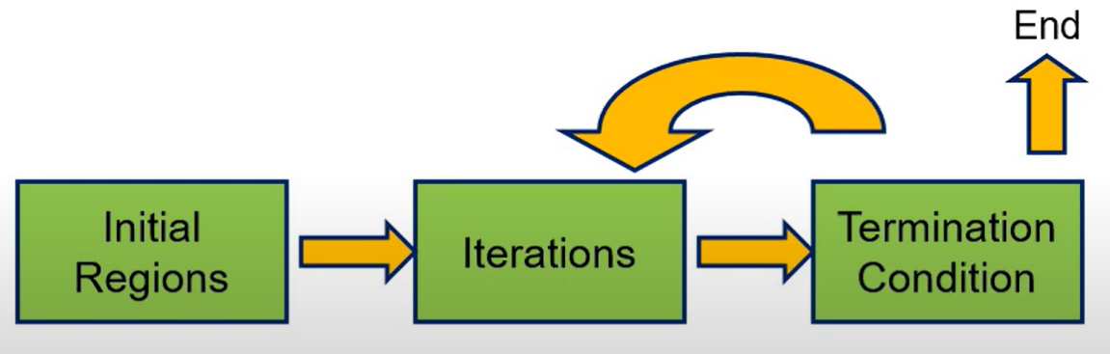
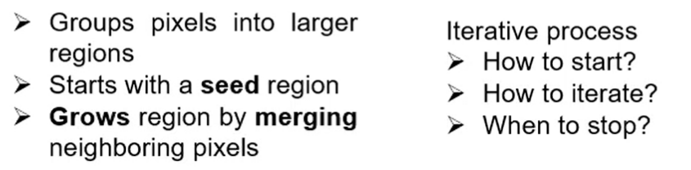
Algorithm
For each region uniformity predicate must be true
For any two adjacent regions, predicate must be false

Slide 6
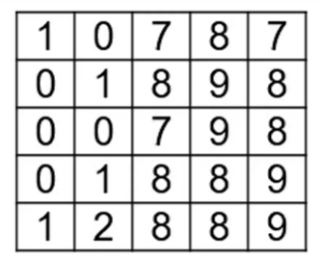
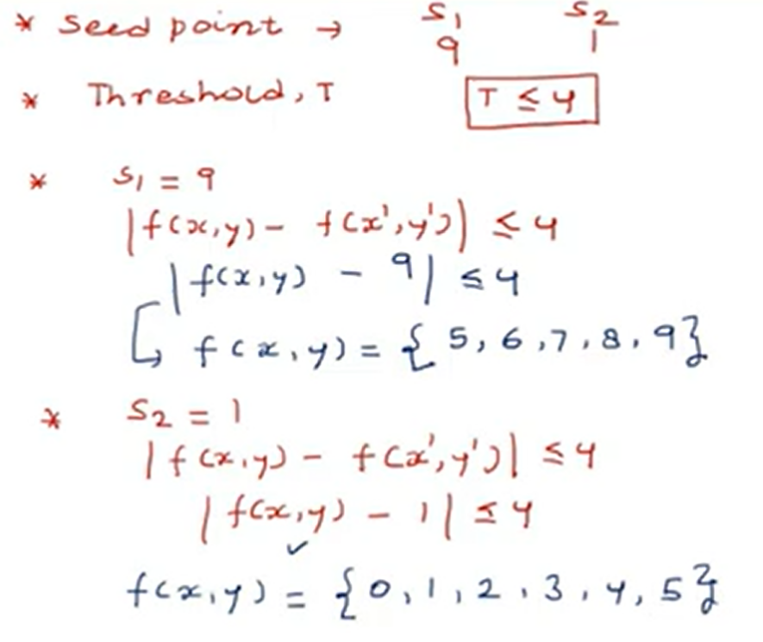
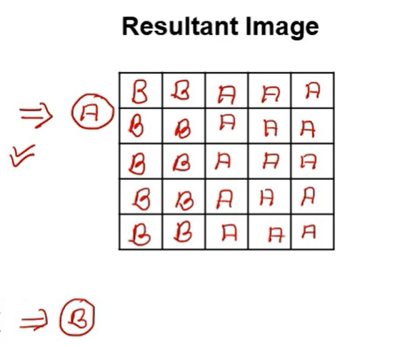
Numerical Example

Slide 7
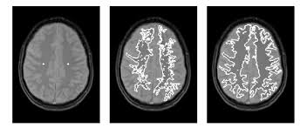

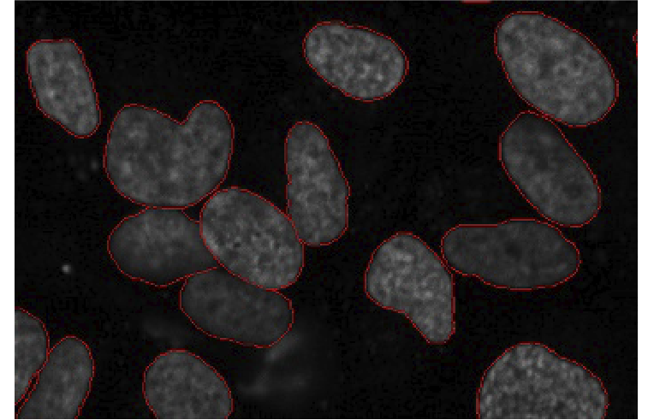
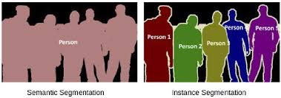
Examples

Slide 8
Steps
Region Growing Algorithm:
The Region Growing algorithm starts from a seed pixel in the image and grows the region by adding neighboring pixels that are similar based on an intensity threshold.
Seed Selection:
The algorithm starts with a seed pixel, which is a randomly chosen point in the image.
Initialize the Region:
A binary output image of the same size as the input image is created, initialized to 0 (black). The region will be grown by setting pixels in this image to 255 (white).
The mean intensity of the region is initialized with the intensity of the seed pixel.
Iterate Over Neighbors:
Check the 4 neighboring pixels (up, down, left, right) of the seed pixel to decide whether they belong to the same region. These neighboring pixels are explored in a breadth-first manner by adding them to a list.
Intensity Check:
For each neighboring pixel calculate the absolute difference between the pixel's intensity and the mean intensity of the current region.
If the intensity difference is less than a user-defined threshold, the pixel is added to the region and the mean intensity of the region is updated.

Slide 9
Stop Condition:
The algorithm continues growing the region until there are no more neighboring pixels that satisfy the intensity difference condition. The algorithm stops when the list of pixels to check is empty.
Result:
The algorithm produces a binary image where the region of interest is highlighted in white (255), and the rest of the image remains black (0).

Slide 10
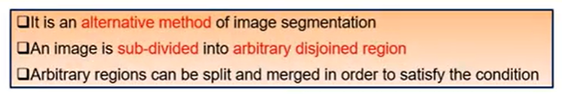
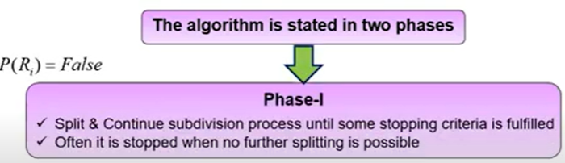
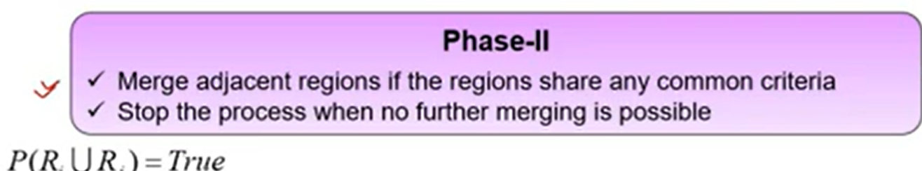
Split and Merge
P(R_{i}) = False
P(R_{i} U R_{j}) = True

Slide 11
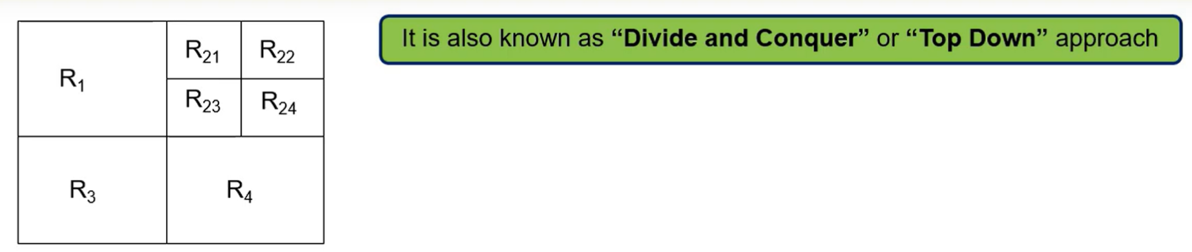
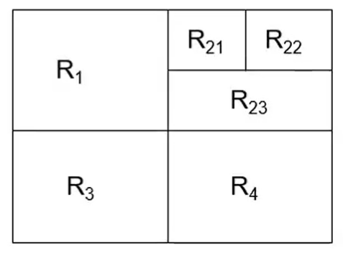
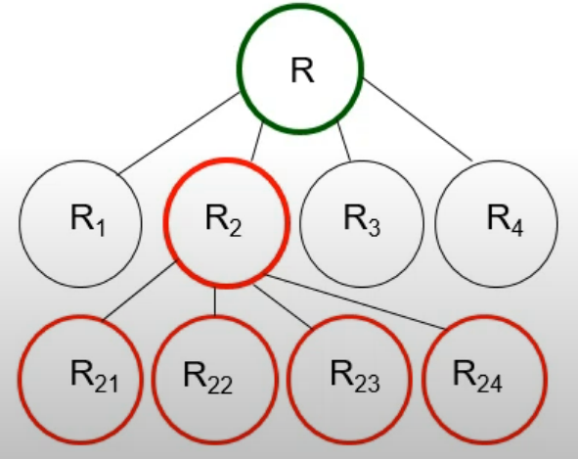
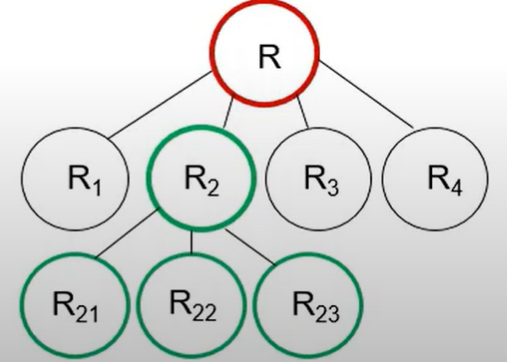

Split
Merge

Slide 12
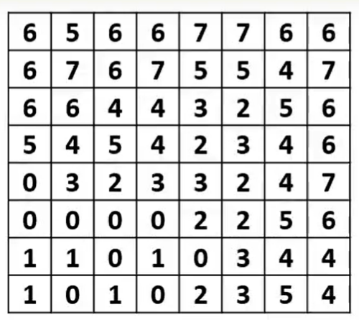
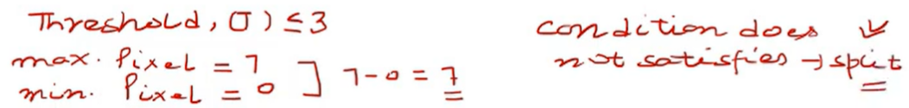
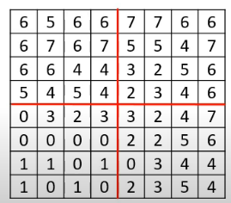

Slide 13
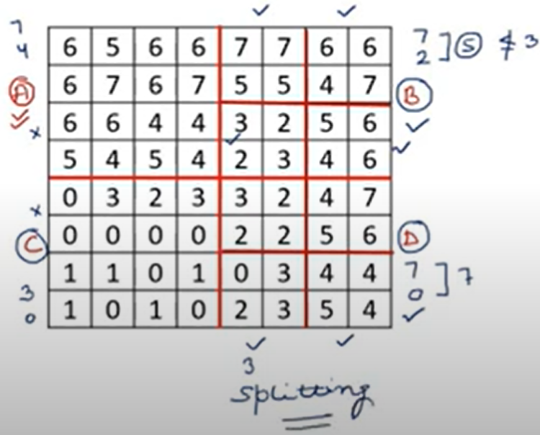
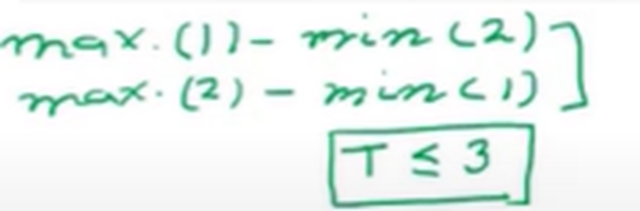

Slide 14
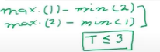
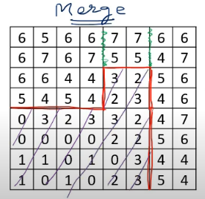

Slide 15
Steps
Start with the Entire Image:
The image is treated as a single region initially, and the algorithm checks whether the intensity variation in this region satisfies the threshold condition. This means checking if the maximum intensity difference within the region is less than the threshold.
Recursive Splitting:
If the intensity difference exceeds the threshold, the image region is recursively split into four smaller sub-regions (top-left, top-right, bottom-left, bottom-right). This recursive splitting continues until the regions are small enough (2x2 pixels) or until the intensity difference within a region satisfies the threshold condition.
Merging Regions:
After splitting the image into smaller regions, the algorithm attempts to merge regions if the combined regions satisfy the threshold condition. This step ensures that neighboring regions that are similar in intensity can be grouped together.
The regions are merged by creating a new image where the sub-regions are placed together.

Slide 16
Stop Condition:
The splitting stops when the regions are small enough or when the intensity variation in the region satisfies the threshold.
Result:
The output is an image where regions are split and merged based on the intensity variation and the threshold. The regions that meet the threshold condition are merged back into larger regions.

